Slide 1
Making EHR Data More Available for Research and Public Health – Hepatitis C Use Case
Division name here
Aaron M. Harris, MD MPH FACP
Abigail Viall, MA
December 4, 2019

Slide 2
Agenda for Call
Introductions
Hepatitis C Virus (HCV)—Background and Use Case Context
HCV Use Case—Vision and Goals
Prioritizing HCV Use Case Scope
Next Steps

Slide 3
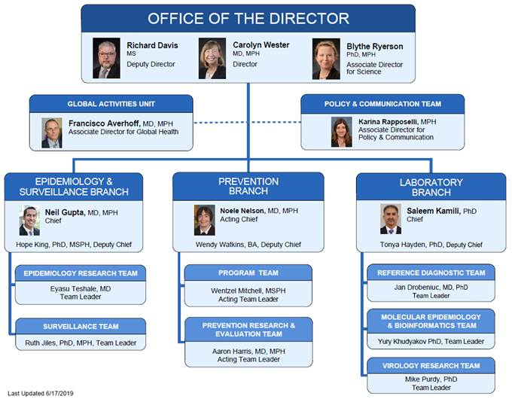
CDC’s Division of Viral Hepatitis
Vision:
  To eliminate viral hepatitis in the United States and worldwide
Goals:
  Decrease incidence and prevalence of viral hepatitis
  Decrease morbidity and mortality from viral hepatitis
  Reduce viral hepatitis-related health disparities

Slide 4
Background on Hepatitis C

Slide 5
Number of acute hepatitis C cases submitted to CDC by states and estimated* number of acute hepatitis C cases — United States, 2010–2017
Source: CDC, National Notifiable Diseases Surveillance System.
Notes:
*The number of estimated viral hepatitis cases was determined by multiplying the number of reported cases by a factor that adjusted for under-ascertainment and under-reporting (5).In this visual representation, the reported and estimated not reported add to the total estimated number of acute cases. The 95% bootstrap confidence intervals for the adjusted number of cases are shown in the Appendix.

Slide 6
Incident Hepatitis C Cases Increasing in Young Adults
Rates of reported incident hepatitis C cases, by select demographic characteristics – United States, 2010-2017
20-29 yrs
Male
30-39 yrs
Female
40-49 yrs
AI/AN
50-59 yrs
White, NH
Black, NH
60+ yrs
Hispanic
0-19 yrs
API
Source: CDC, National Notifiable Diseases Surveillance System.

Slide 7
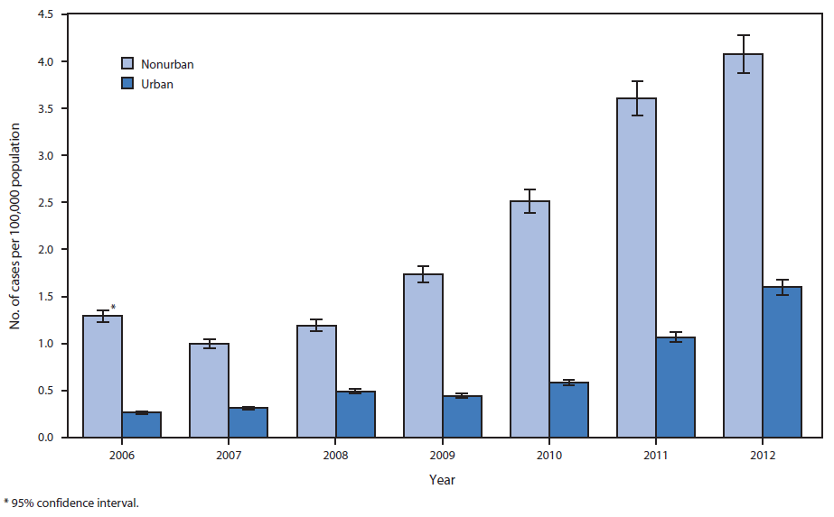
Incidence of acute hepatitis C among persons aged <30 years, by urbanicity and year – KY, TN, VA, WV, 2006--2012
75% report injection drug use
Source: CDC, MMWR 2015; 64(17):453

Slide 8
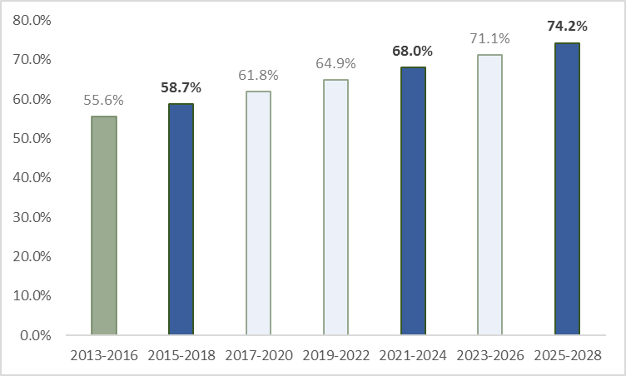
Only Half of People Living with Hepatitis C Currently Aware of Infection
 |  |  | 2025 |  | 2030 | Target year
5.6 | 11.2 | 16.7 | 22.3 | 27.9 | 33.5 | Percent increase
= current data
= projected data
70%
Source: NHANES
2013-2016 is the most recently published estimate; 2015-2018 projected to be available December 2019.

Slide 9
Hepatitis C Elimination Goals

Slide 10
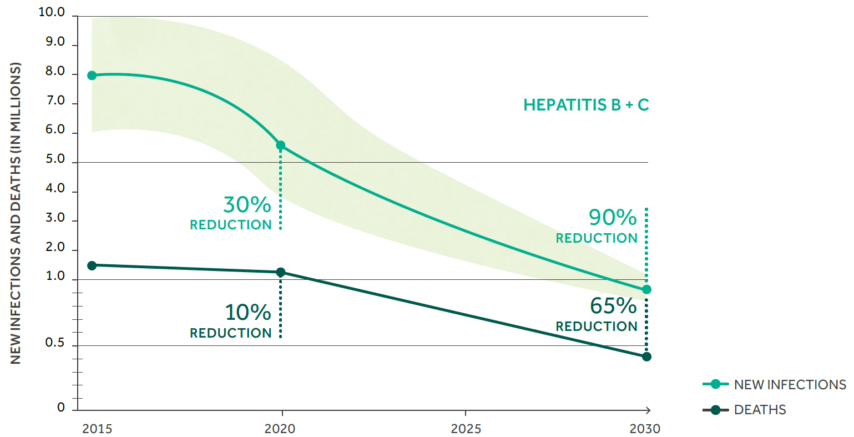
Global Viral Hepatitis Targets Include Incremental Reductions
Global Health Sector Strategy on Viral Hepatitis, 2016-2021: 2020 & 2030 Targets (WHO, 2016)

Slide 11

Eliminating the Public Health Problem of Hepatitis B and C in the United States
PHASE 1
Focus
  Determine whether elimination goals for HBV and HCV
  are feasible in the United States
  Identify possible critical success factors
Relevant Findings
  Eliminating the public health problem of hepatitis C is feasible if key barriers are addressed
    One noteworthy barrier cited by report: Inadequate surveillance systems

Slide 12
A National Strategy for the Elimination of Hepatitis B and C
PHASE 2
Focus
  Prepare a consensus report that proposes feasible
  elimination goals to be reached by 2030, and specify
  a plan of action to achieve the goals
  Identify key interventions, roles of stakeholders, barriers,
  prevention research needs, and technology development
  needs
Relevant Findings
  Meeting WHO goals in the U.S. is feasible
  Requires major investments in availability, accessibility, and delivery of key interventions, as well as data needed to direct and monitor effects of elimination efforts

Slide 13
Eliminating the Public Health Threat of Viral Hepatitis in the United States - 2030 Targets
Target | 2030 Targets | Performance Measures
HCV mortality | 65% reduction (baseline: 21,600 deaths in 2015) | Treat: 260,000 cases/year (2017-2030) Newly diagnose: 110,000 cases/year (2017-2019) 89,000 cases/year (2020-2024) 72,000 cases/year (2025-2030) Reduce new infections to: 23,000 cases/year (2017-2019) 11,000 cases/year (2020-2024) 3,000 cases/year (2025-2030)
HCV incidence | 90% reduction (baseline: 30,340 new cases in 2015)

Slide 14
CDC Glide Path to National Target: Percentage of People with HCV infection Aware of Their Infection
Source: NHANES
2013-2016 is the most recently published estimate; 2015-2018 projected to be available December 2019.
Notes:
Information on this slide is from Excel file DVH SP 2025 targets.xlsx Tab 4hepBaware
Elimination goal is 90% aware

Slide 15
CDC Glide Path to National Target: Percentage of People with HCV infection Who Initiated HCV Treatment
Source: NHANES
2013-2016 is the most recently published data; estimates presented are unpublished and based on small numbers.
Notes:
Information on this slide is from Excel file DVH SP 2025 targets.xlsx Tab 5hepCtreated
Check core data, estimate from NHANES – 19 persons who were HCV RNA positive reported ever having been treated, another 19 who were HCV RNA negative reported ever having been treated, another 1 who was HCV antibody positive reported ever having been treated, and 6 who lacked laboratory data for hepatitis C reported ever having been treated for hepatitis C.
30% (unweighted, 34.8% weighted) of those who self-reported ever having been told they had hepatitis C reported ever having been treated for it.
31.1% (unweighted, 30.7% weighted) of those who were HCV RNA+ reported ever having been treated for hepatitis C.
Elimination goal 260,000/year cured from 2015-2030

Slide 16
Leveraging Data to Achieve Elimination Goals

Slide 17

No single data source is sufficient to capture hepatitis C-related burden and outcomes at national, state, and local levels for all populations of interest
Commercially
insured
Medicaid
PWID
Uninsured
Medicare
Incarcerated
Rural
Co-infected

Slide 18
A Sample Hepatitis C Diagnosis and Treatment Cascade Components
HCV Health Services Research
Claims Data --- CPT Codes (Procedure Codes)
Laboratory Test Results (LabCorp & Quest Results)
Claims Data --- ICD Codes (Diagnosis Codes for Billing)
Pharmacy RX Data (IMS / IQVIA)
CPT Code Test Result CPT Code Test Result CPT/ICD Rx filled CPT Code Test Result
Notes:
So what type of national data sources exist, and how might they be used to build an accurate snapshot of the national viral hepatitis care cascades.
This slide demonstrates multiple elements of a sample HCV Cascade of Cure – the way that each step is measured may vary depending upon the data source.
For example:
-- Claims data provides CPT / ICD codes reflecting tests ordered, diagnoses made, provider visits conducted, and prescriptions filled
-- Prescription data bases provide prescriptions filled
-- Lab results provide tests conducted as well as associated results

Slide 19
Current state of hepatitis C diagnosis, linkage to care, and treatment, NHANES, United States, 2013
2.4 million living with hepatitis C¹
58.7% aware of infection²
21% linked to care³
<10% are treated³
¹Hofmeister MG et al.Hepatology.2019; ²NHANES 2013-2016 published estimate; ³Holmberg SD et al.N Engl J Med.2013
Notes:
Main messages here being:
Clearly a lot of room for improvement across care cascade—and if we want to achieve elimination goals, we need to be actively monitoring progress towards closing gaps
BUT we have to use special surveys to get a national picture--and it’s an imperfect one at that (point in time, key populations omitted, etc.).
AND for most states/locals, there aren’t even these imperfect survey alternatives

Slide 20
Limitations to NHANES and NNDSS
NHANES
  Non-household populations excluded (homeless, incarcerated, etc)
  Survey changes over time
  Self reported variables
  Only useful at national level
NNDSS
  Administratively cumbersome, manual reporting processes +
  Variable reporting requirements across jurisdictions =
  Data = incomplete, inconsistent, not timely

Slide 21
Use of Electronic Health Record Data for Monitoring Progress Toward Hepatitis C Elimination Goals
Pros
  Longitudinal analysis
  Laboratory results to confirm diagnosis
  Treatment information to confirm treatment prescribed
  Data captured as part of general workflow processes
  Emerging standards for representation and exchange
Cons
  Missing/incomplete data
  Data cleaning
  Only captures patients receiving care
  Interoperability across health systems

Slide 22
Example Hepatitis C Care Cascade from EHR data for research and public health, Grady Health System, 2016
72 745 persons received HCV testing
4224 HCV RNA +
909 Treated
72,745
4224 (5.8%)
909 (22%)
Miller LM et al.J Viral Hepatitis.2019

Slide 23
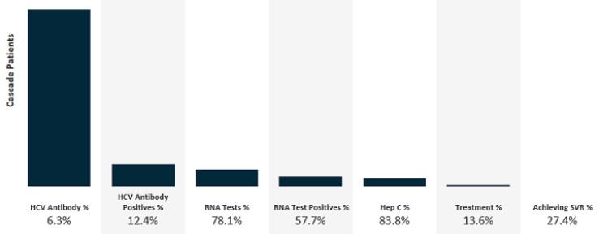
Example Hepatitis C Care Cascade from EHR data for research and public health, OCHIN, 2019

Slide 24
Hepatitis C Use Case: Vision, Goals, Scope

Slide 25
Hepatitis C Use Case: Vision
Complete capture/reporting of individual level data necessary to construct, monitor, and improve outcomes along the care cascade at local, regional, state, and national levels
Access to additional clinical or social service data needed to address specific research questions or better target clinical, population health interventions

Slide 26
Hepatitis C Use Case Primary Goal: Core Elements of Care Cascade
*HCV testing
  Anti-HCV
  HCV RNA
  HCV genotype
Hepatitis C diagnosis
Treated
  Prescribed direct acting antiviral
Cured (SVR)?
  negative HCV RNA > 3 months after completing treatment

Slide 27
Hepatitis C Use Case: Secondary Goal
Additional clinical and social data captured/reported (ideal) or accessible through follow-up requests/query
  Behavioral risk factors or co-morbidities (e.g., injection drug use, OUD/SUD)
  Initiation and adherence to MAT
  Shifts in severity, service utilization associated with co-morbidities potentially sensitive to HCV infection (e.g., diabetes)
  Linkage to/receipt of recommended preventive (e.g., HBV vaccination) and support (e.g., peer recovery, housing assistance) services

Slide 28
HCV Use Case Scoping Questions
What is a reasonable set of use case functions to tackle as part of this project?
What jurisdictional “level(s)” should we pursue for use case function development?
  Among local stakeholders
  Local→ state
  State→ national?
Notes:
Use case function prompts:
1. Data transfer / reporting
2. Apply measures or rules to analyze / prepare data
3. Operate a non-EHR data store in clinical care
4. Record "new" or "special" data not otherwise found in EHR
5. Support externally generated “live” queries for investigation / follow-up
Use case level(s) prompts:
We’ve described the case for national elimination—and several states (e.g., WA, NY) have, or are developing, state elimination plans. But both state and national success really begin at/rest on effective local efforts—for example, micro-elimination at the city or county level. If we could effectively and efficiently build the platform to generate and use care cascades at the community level to inform and direct both public and private investments and action……..well, that alone would be huge.
And maybe it’s enough to build our use case there. It seems manageable to test—but still challenging enough to design. And an archetype for building a community outcome continuum dashboard in HCV could prove broadly valuable
Or is it too challenging (e.g., in cases where LHD doesn’t have bandwidth or authority to receive data)?
Or not challenging enough?
Or not the best investment of resources, given some of the path already blazed for eCR by Digital Bridge?
In short, is local→ state reporting and care cascade assembly and use for elimination a better/more reasonable scope? Is it reasonable to build/test both (e.g., should we try to engage/pilot with a city and the state to which it belongs? In city test, we might try to recruit providers/health systems that account for 80% of care in county; in state test, we might try to report from city to state………or directly from those same providers to state?)
And do we dare even consider how these data might eventually make their way to CDC? Or is that outside of scope (especially since potentially least impactful from a “motivating and directing action perspective”……….though potentially helpful for research)

Slide 30
Extra Slides

Slide 31
Public Health Reporting Function: Digging into Details
What are the relevant data classes and elements from USCDI? Which are the most important to prioritize?
  Ex. Labs (tests, results), Medication, Patient Demographics, Problems
  But Assessment and Plan of Care, Health Concerns, Immunizations, Procedures?
Are there other data we need to supplement USCDI? And is it reasonable, feasible, and/or valuable to “build in” optionality for these now?
  Ex. Pregnancy status, social/behavioral data like drug/alcohol use or housing insecurity
Notes:
While we WANT all the information fields available/captured under USCDI, if we have to PRIORITIZE, the most important pieces would be:
Labs (tests, results)
Medications
Patient Clinical Problems
Medical Encounters and Diagnoses
Patient Demographics
Secondary priorities: Immunizations, race/ethnicity, SOGI, social/behavioral data
“Level” distinction: clinic to local registry vs. clinic to state/local HD vs. state to CDC
Aggregation: Individual level with PII; individual level anonymized; aggregate counts

Slide 32
Public Health Reporting Function: Details (2)
What are the relevant authorities and reporting incentives (e.g., state, federal regs) to consider?
  Do they vary by desired classes and elements from the USCDI?
    Or certain kinds of data captured within USCDI classes and elements (e.g., SUD)?
  Do they vary by level of “level” and degree of aggregation?
What are the relevant standards, and are there implementation guides to support their application in this case?
Notes:
“Level” distinction: clinic to local registry vs. clinic to state/local HD vs. state to CDC
Aggregation: Individual level with PII; individual level anonymized; aggregate counts

Slide 33
Public Health Reporting Function: Details (3)
What trigger or combination of triggers allow us to track outcomes along the care cascade AND minimize burden on providers, health systems, and health departments?
  Testing
  Diagnosis
  Treatment
  Cure (SVR)
Notes:
In facilitation, we need to walk through definitions for each (Aaron, we can pull from those you proposed in the slides I cut and moved to end), frequency, and trigger types in facilitation guide John’s been working on (see below). I suspect the “trigger answer” (including frequency) may vary by care cascade element and decisions made earlier in use case conversation (e.g., individual, aggregate data reports)
What initiates the “data transfer / report”?
Data trigger (e.g. specific diagnosis is recorded)
Workflow trigger (e.g. patient discharge)
Timed trigger (e.g. every month)
Manual initiation
Other

